Slide 1
Crime Incidents Analysis
Chunxia Cao
Gainesville, 04142020

Slide 2
OUTLINE
Predictive Analytics
(Insights)
Descriptive Analytics
(Themes)
Prescriptive Analytics
(recommendations)
Python 3.7.4
Tableau Desktop 2019.4

Slide 3
Data Collection and Cleaning
Descriptive Analytics
Crime Incidents - https://data.cityofgainesville.org/Community-Model/Crime-Incidents-2011-Present/gvua-xt9q
Crime incidents reported from 2011 to present(4/10/2020)
157K rows and 22 Columns (today, 14 columns)
Missing values
Typos
Add a variable ‘Delay’

Slide 4
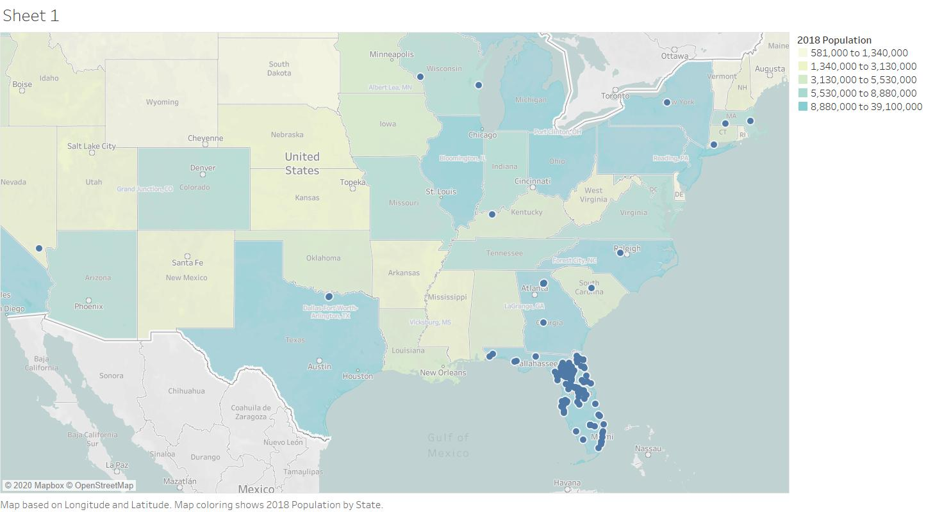
Incident Locations _ distribution
Descriptive Analytics

Slide 5
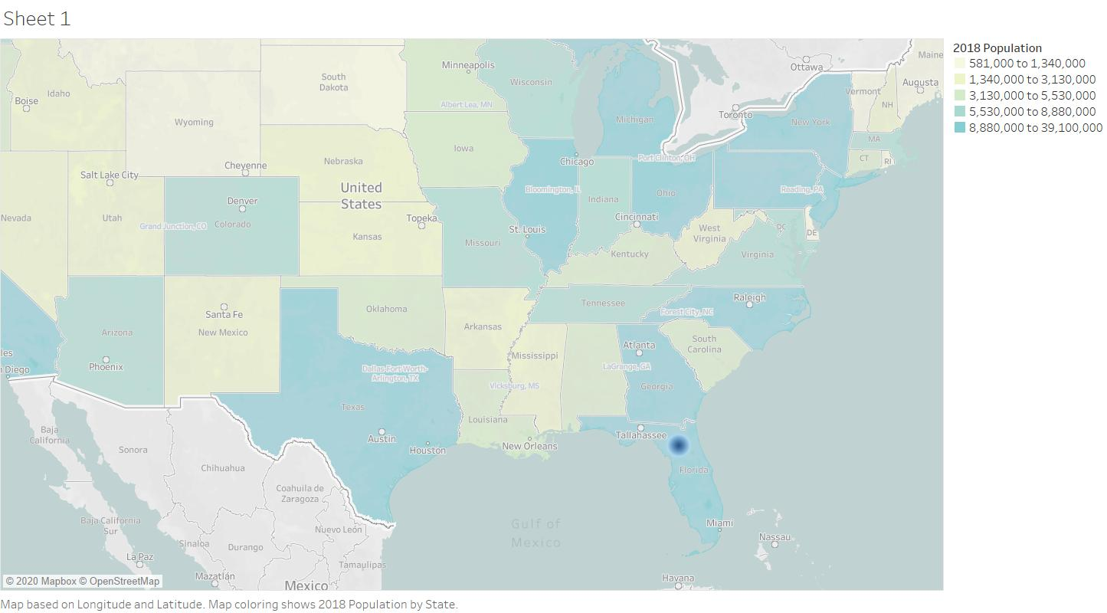
Incident Locations _ density
Descriptive Analytics

Slide 6
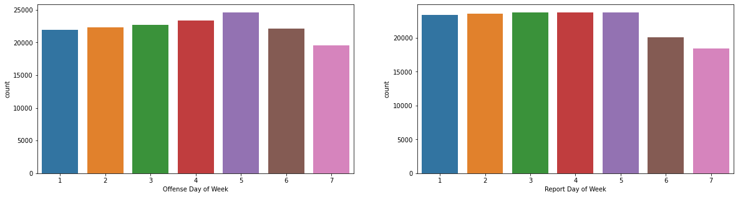
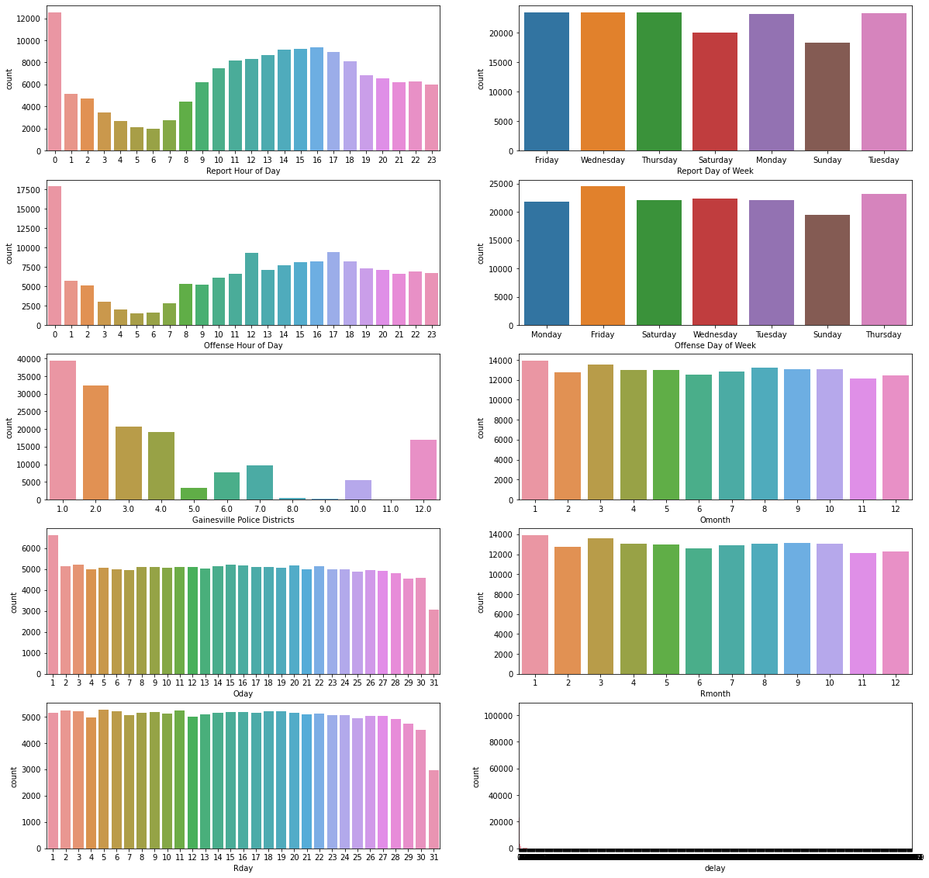
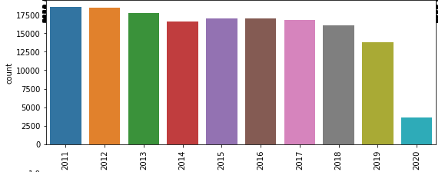
Overview
Descriptive Analytics

Slide 7
Overview
Descriptive Analytics

Slide 8
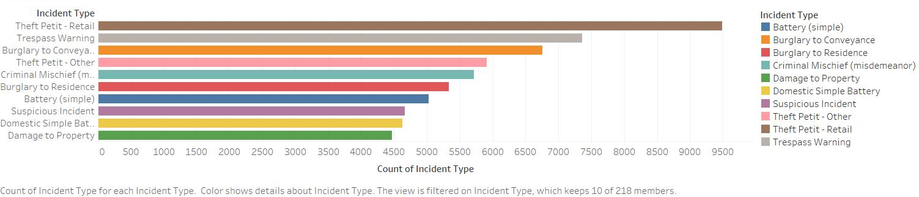
Top10 Incidents
Descriptive Analytics
38.18% of all Incidents

Slide 9
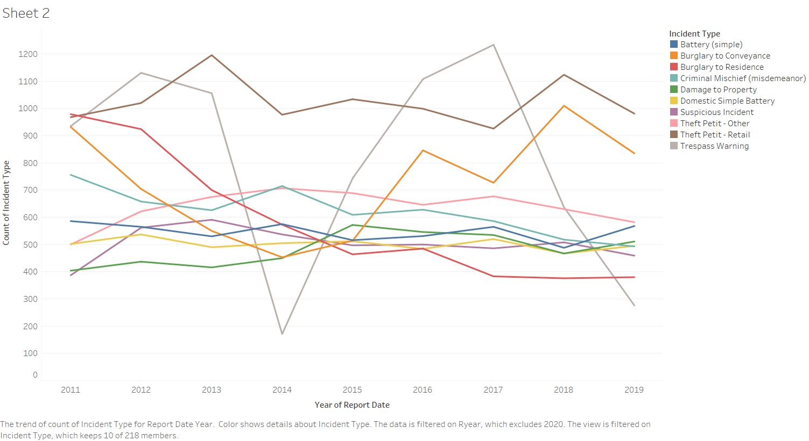
Top10 Incidents 2011-2019
Descriptive Analytics
38.18% of all Incidents

Slide 10
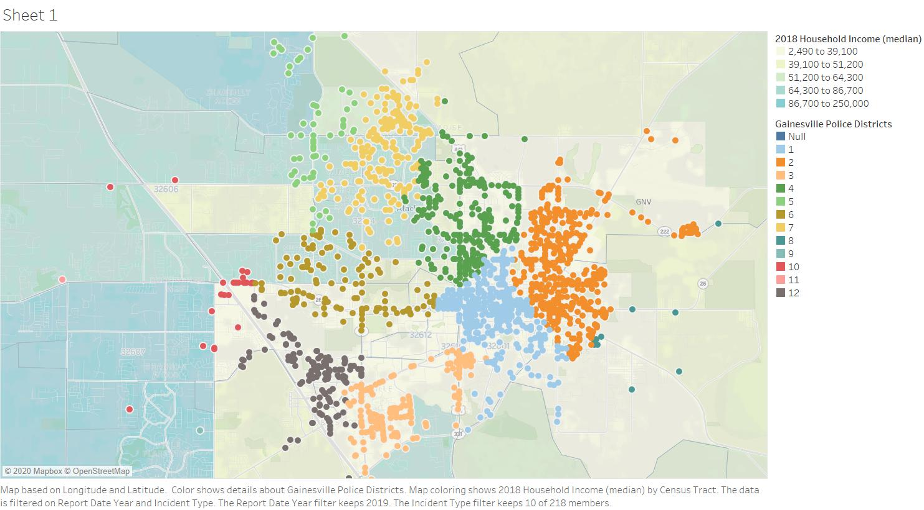
Top10 Incidents 2019
Descriptive Analytics
38.18% of all Incidents

Slide 11
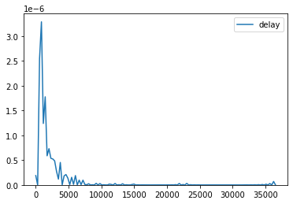
Delay Reporting
Descriptive Analytics
count 156619.000000
mean 13.510117
std 222.092117
min 0.000000
25% 0.000000
50% 0.000000
75% 1.000000
max 36519.000000

Slide 12
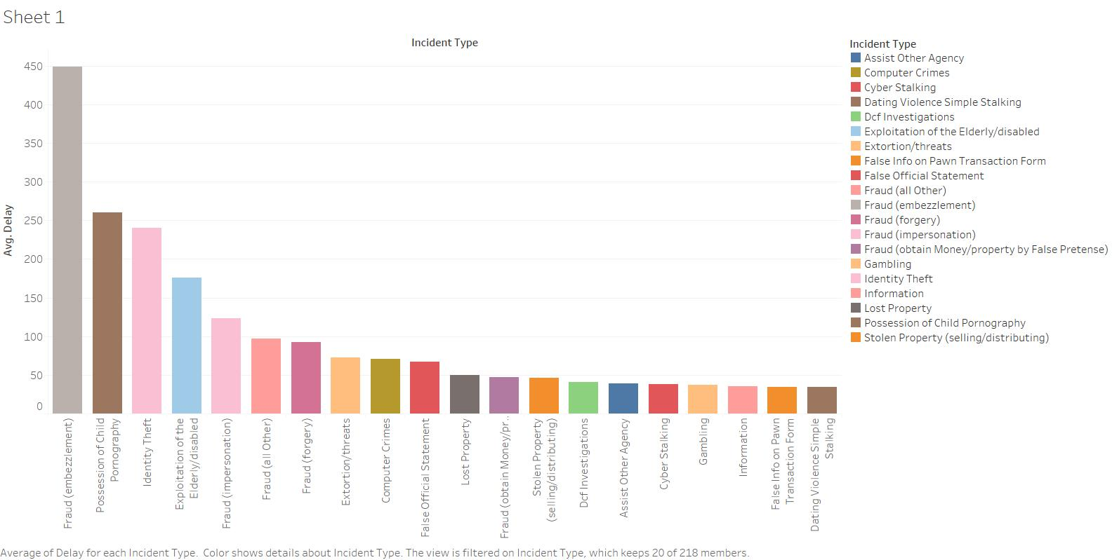
Delay Reporting
Descriptive Analytics

Slide 13
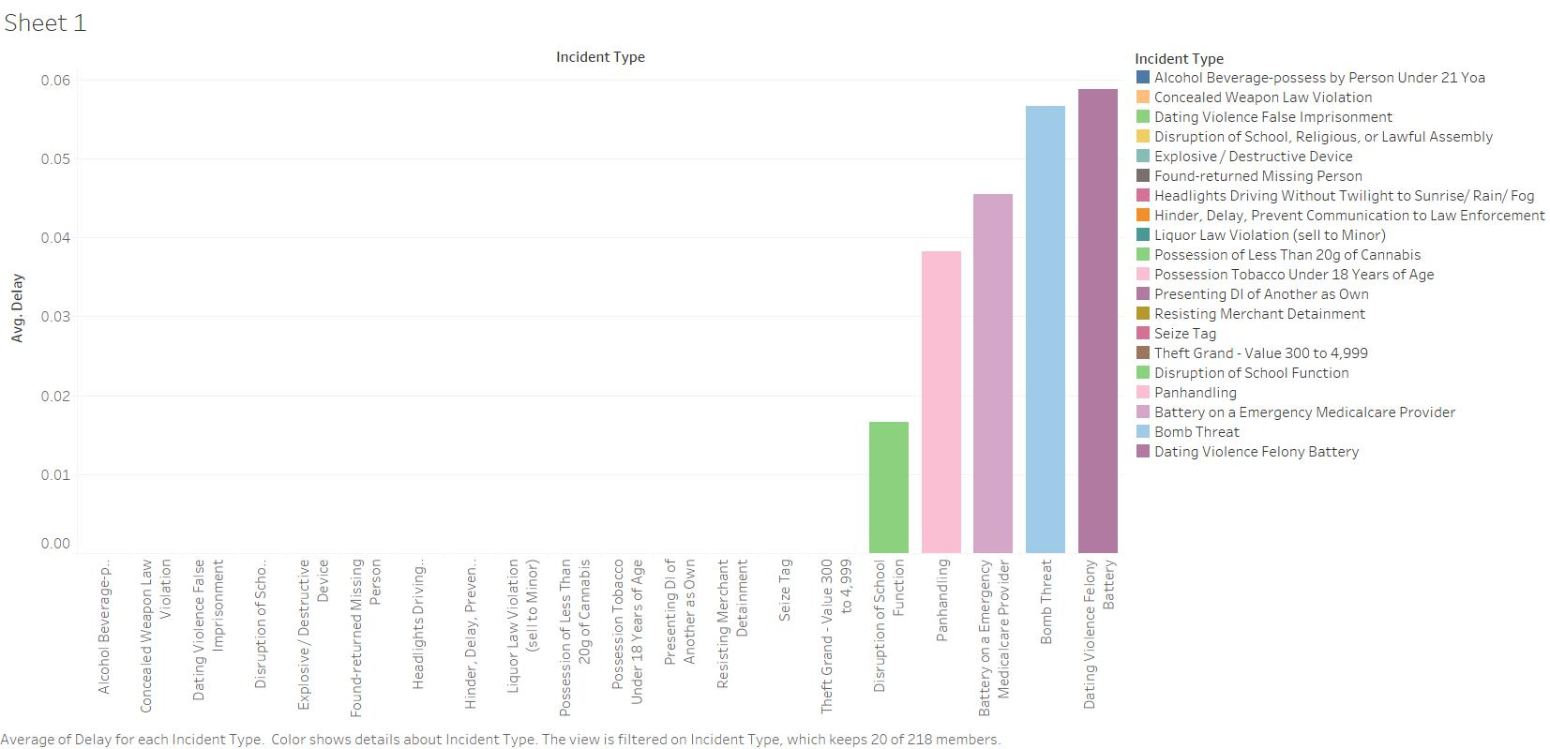
Delay Reporting
Descriptive Analytics

Slide 14
Supervised Machine Learning
Predictive Analytics
Aim: Seek to predict which category of crime is most likely to occur given a time and place in Gainesville
Data: Subset top 5 incidents (Burglary to Conveyance, Criminal Mischief (misdemeanor), Theft Petit - Other, Theft Petit – Retail and Trespass Warning), with time and location information as predictors.
Method: Try out multiple classification algorithms including KNN, Support Vector Machine, AdaBoost and Decision Tree. Using Random Forest to select variables. compare classifier by accuracy
Result: Decision Tree gets best accuracy

Slide 15
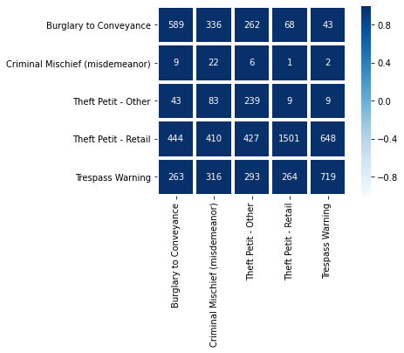
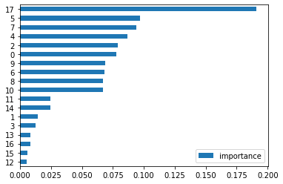
Classification_ Random forest
Predictive Analytics
"Gini importance" of each feature:

Slide 16
Classification_ Classifiers
Predictive Analytics
Testing Accuarcy of AdaBoost is: 0.519
Testing Accuarcy of SVM is: 0.532
Testing Accuarcy of Decision Tree is: 0.551
Testing Accuarcy of KNN is: 0.517

Slide 17
Unsupervised Machine Learning
Predictive Analytics
Aim: Group data points into a small number of clusters to find high incidents area.
Data: Top 5 incidents in 12 Gainesville Police Districts.
Method: k-means clustering
Result: 2 clusters were defined

Slide 18
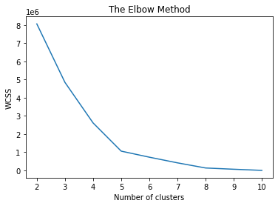
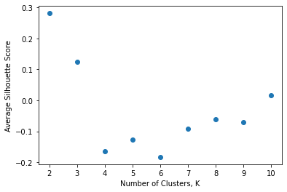
Unsupervised Machine Learning
Predictive Analytics

Slide 19
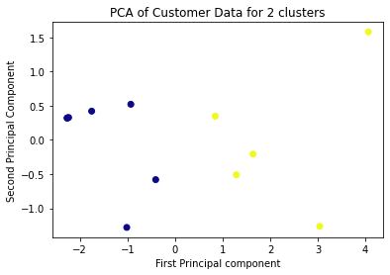
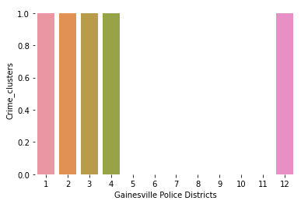
Unsupervised Machine Learning
Predictive Analytics

Slide 20
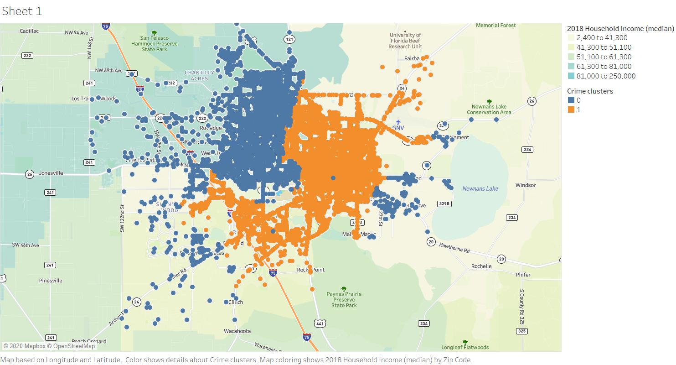
Unsupervised Machine Learning
Predictive Analytics

Slide 21
Time Series_ Forecasting
Predictive Analytics
Aim: Make short-term forecasting of incidents
Data: Number of incidents with time series.
Method: ARIMA
Result: Forecasting model is established

Slide 22
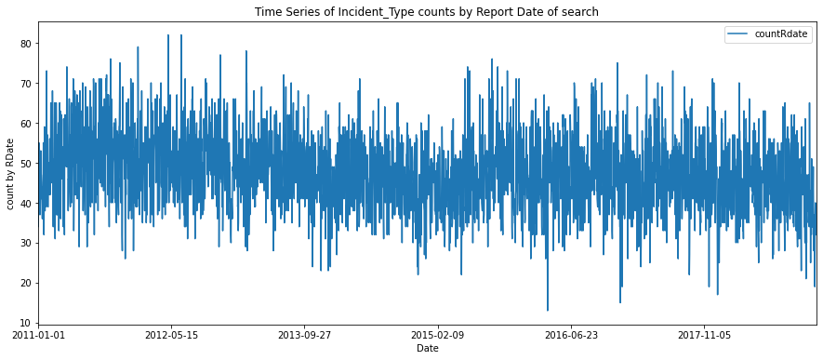
Time Series_ time series by date
Predictive Analytics

Slide 23
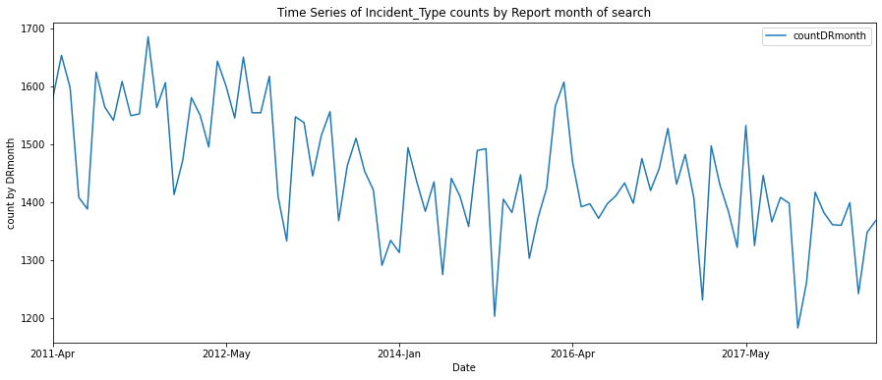
Time Series_ time series by month
Predictive Analytics

Slide 24
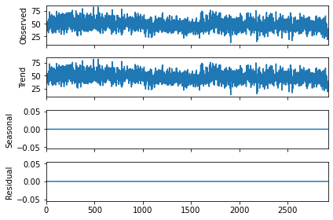
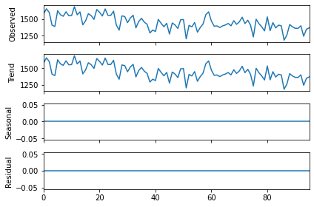
Time Series_ decompose
Predictive Analytics

Slide 25
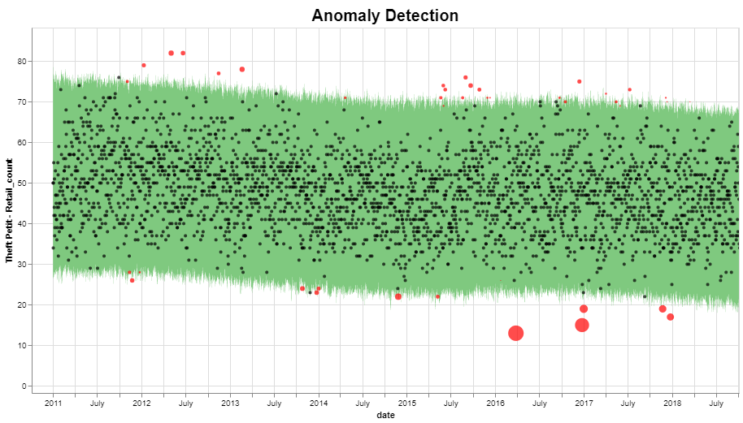
Time Series_ anomaly detection by date
Predictive Analytics
fbprophet

Slide 26
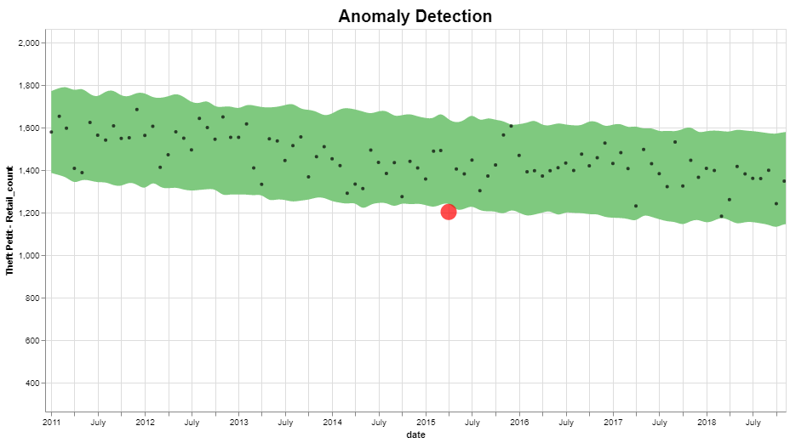
Time Series_ anomaly detection by month
Predictive Analytics
fbprophet

Slide 27
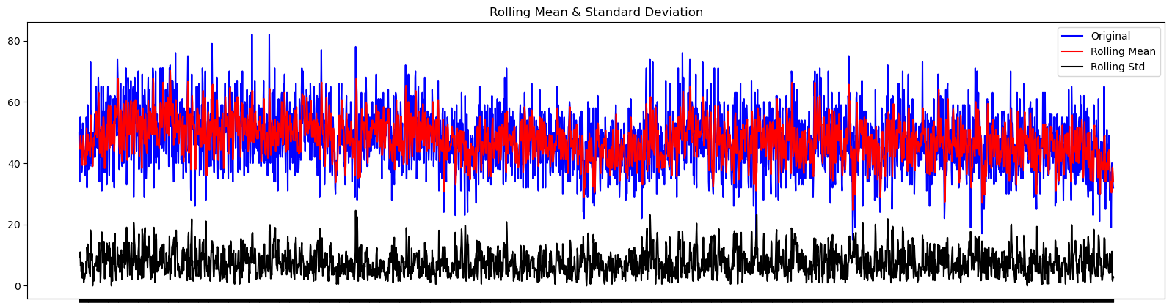
Time Series_ stationary by date
Predictive Analytics
Results of Dickey-Fuller Test:
Test Statistic -4.648966
Critical Value (1%) -3.432612
Critical Value (5%) -2.862540
Critical Value (10%) -2.567302

Slide 28
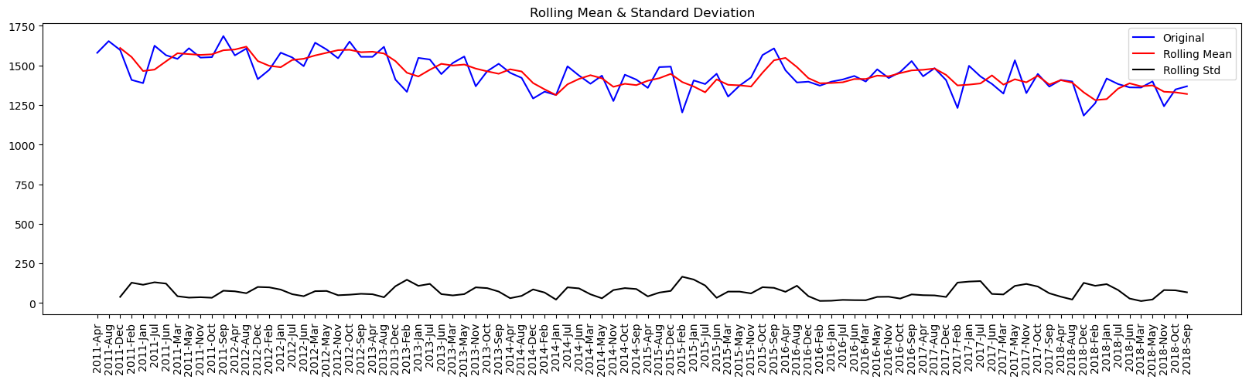
Time Series_ stationary by month
Predictive Analytics
Results of Dickey-Fuller Test:
Test Statistic -0.921988
Critical Value (1%) -3.510712
Critical Value (5%) -2.896616
Critical Value (10%) -2.585482

Slide 29
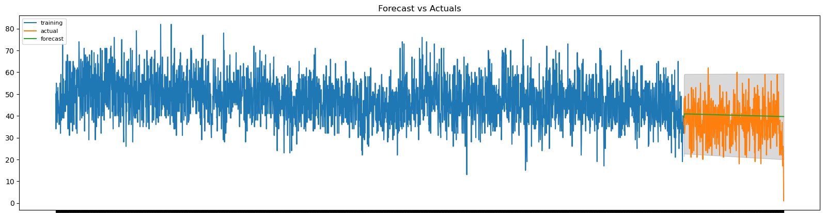
Time Series_ ARIMA
Predictive Analytics
Test MSE: 77.140

Slide 30
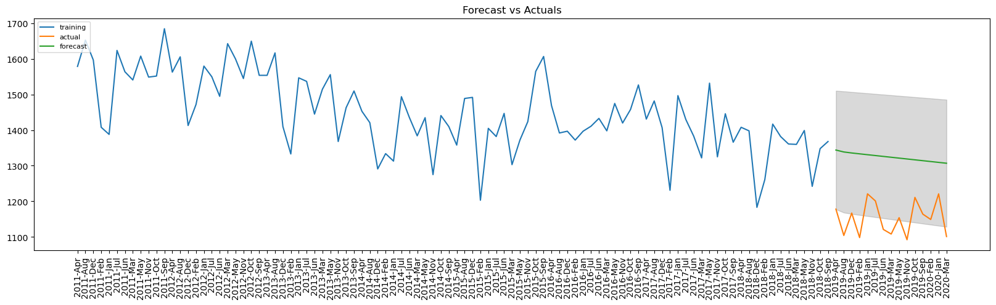
Time Series_ ARIMA
Predictive Analytics
Test MSE: 31563.686

Slide 31
Conclusion
Predictive Analytics
The supervised classification method could classify a criminal incident by type, depending on its occurrent at a given time and location.
The clustering algorithm could be applied to predict crime prone areas
Time series analysis can be used in prophet forecasting to the time series of actual crime and public offense counts

Slide 32
Recommendations
Prescriptive Analytics
Reporting delay on some incidents was observed. Further investigation would need to determine the reason and improve the situation
Interactive map can be applied to track cases in real-time
Anomaly detection model can be applied to detect abnormal events.
Based on the prediction of the incidents by classification and time series analysis, combing with crime type distribution, hour of day, and hotspots by clustering, the increase/decrease dispatch could be monitored.

Slide 33

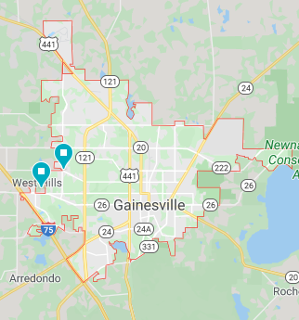
THANK YOU

